Slide 1
Final Report - Recommendation system
Machine Learning Capston - IBM Professional Certificate

Slide 2
Outline
Introduction
Exploratory Data Analysis
Content-based recommendation using user profile and course genres
Content-based recommendation system using course similarity
Content-based recommendation system using user profile clustering
KNN based collaborative filtering
NMF based collaborative filtering
Neural network embedding based collaborative filtering
Collaborative filtering algorithms evaluation
Conclusion
Innovative Insights

Slide 3
Introduction
This project is currently at the Proof of Concept (PoC) phase so the main focus at this moment is to explore and compare various machine learning models and find one with the best performance in off-line evaluations.
A course recommendation system will help in:
• Finding better courses
• Finding courses that well suits each person’s interests
• We aim to find the best courses to recommend to users based on their interests, their friend’s interests, and the courses they are enrolled in.

Slide 4
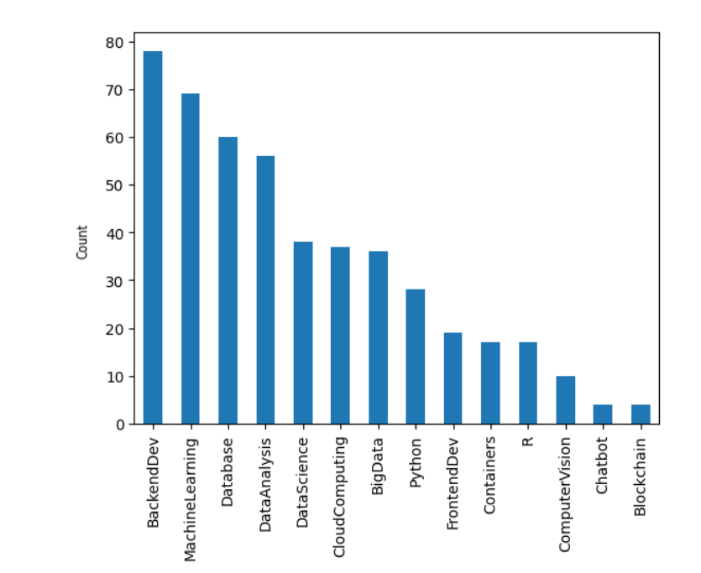
Exploratory Data Analysis
Course Counts Per Genre

Slide 5
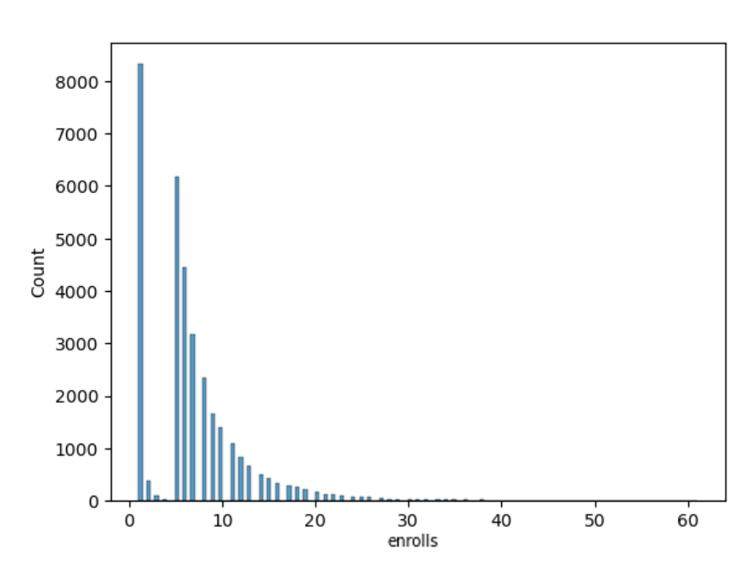
Exploratory Data Analysis
Course Enrollment Distribution

Slide 6
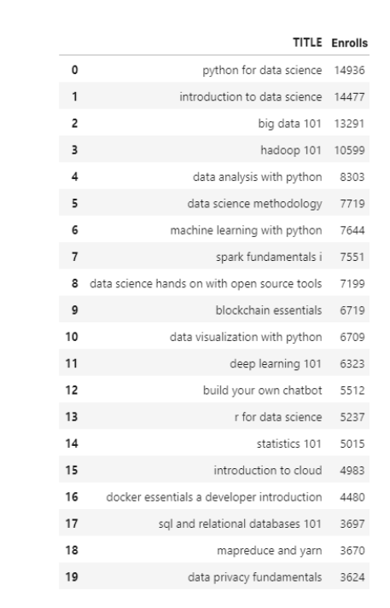
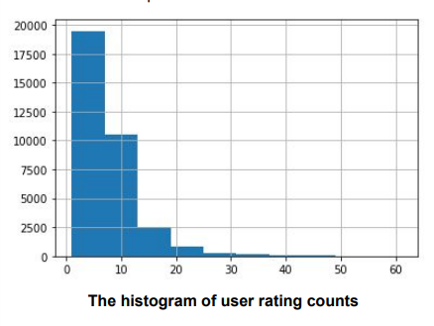
Exploratory Data Analysis
20 Most Popular Courses

Slide 7
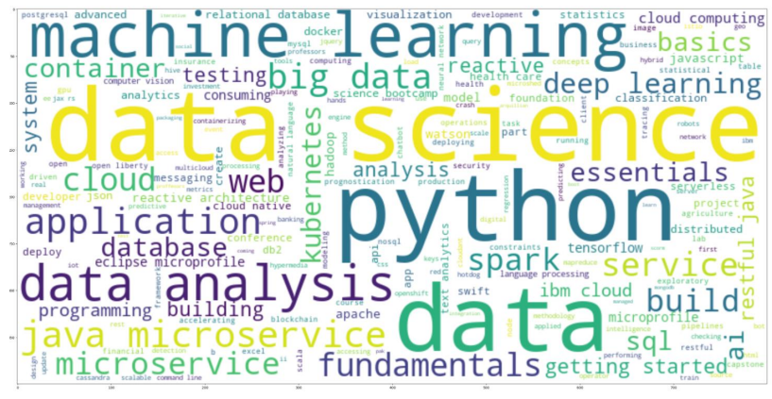
Exploratory Data Analysis
The 5 most common words used in the Title:
Data
Data Science
Python
Machine Learning
Data Analysis
Word cloud of Course Titles

Slide 8
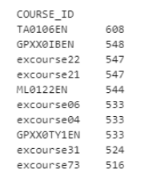
Content-based recommendation using user profile and course genres
with K= 10 (Score_threshold)
On average, how many new/unseen courses have been recommended per user (in the test user dataset) 18.82
What are the most frequently recommended courses?
Return
the top10 commonly recommended courses across all users

Slide 9
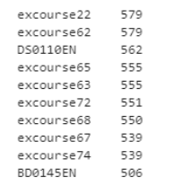
Course similarity based recommender system
with Threshold = 0.6
On average, how many new/unseen courses have been recommended per user (in the test user dataset) 11.37
What are the most frequently recommended courses?
Return
the top10 commonly recommended courses across all users

Slide 10
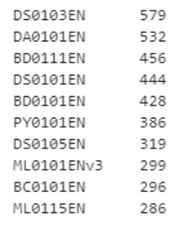
Clustering-based recommender system
with Number of clusters = 20
On average, how many new/unseen courses have been recommended per user (in the test user dataset) 5.73
What are the most frequently recommended courses?
Return
the top10 commonly recommended courses across all users

Slide 11
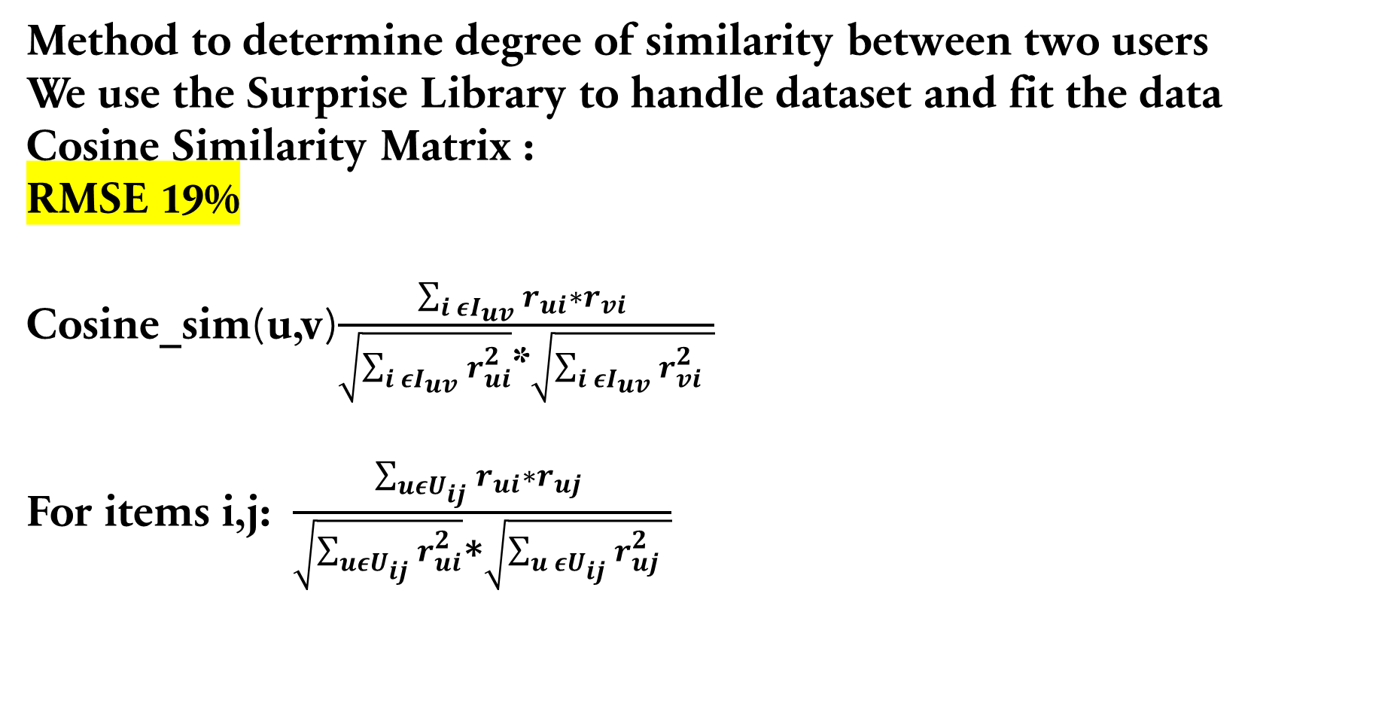
KNN based recommender system
Method to determine degree of similarity between two users
We use the Surprise Library to handle dataset and fit the data
Cosine Similarity Matrix :
RMSE 19%
Cosine_sim(u,v)$\frac{\sum_{i εI_{uv}}{r_{ui}∗r_{vi} }}{\sqrt{\sum_{i εI_{uv}}{r_{ui}^{2}}}\text{∗}\sqrt{\sum_{i εI_{uv}}{r_{vi }^{2}}}}$
For items i,j: $\frac{\sum_{uεU_{ij}}{r_{ui}∗r_{uj} }}{\sqrt{\sum_{uεU_{ij}}{r_{ui}^{2}}}\text{∗}\sqrt{\sum_{u εU_{ij}}{r_{uj }^{2}}}}$

Slide 12
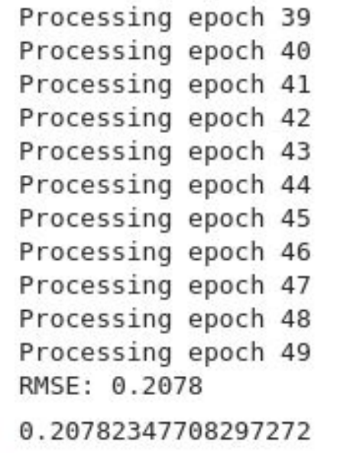
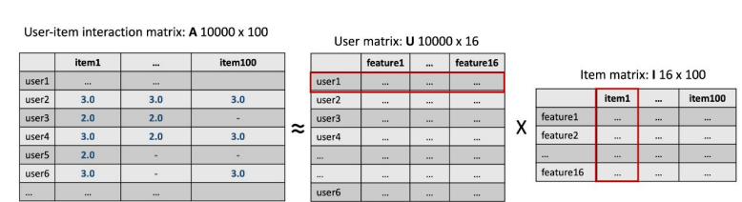
NMF based recommender system
A dimensionality reduction algorithm called Non-negative matrix factorization (NMF), which decomposes a big sparse matrix into two smaller and dense matrices.
Use surprise library to decompose full matrix to two smaller and denser ones: user matrix and item matrix
Dot product each row in user matrix with each column in item matrix
Make prediction by test data, use RMSE metric to evaluate model performance
RMSE 20%

Slide 13
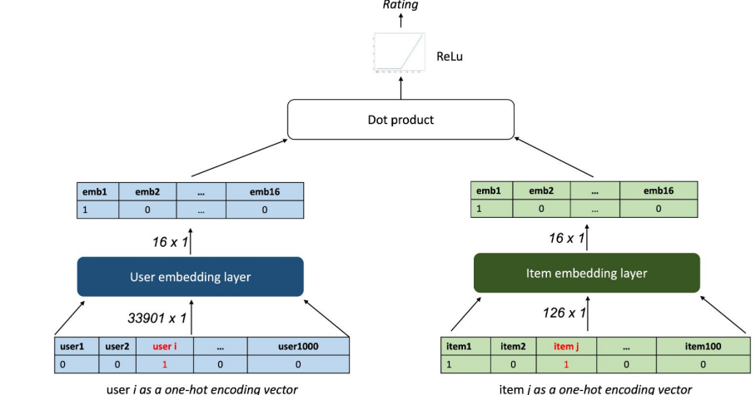
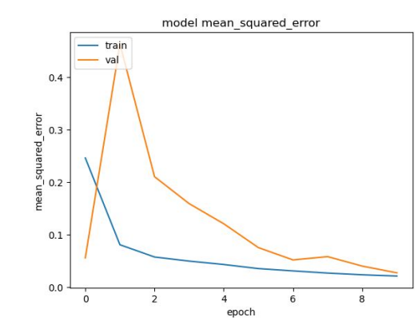
Neural Network Embedding based recommender system
Model:
Optimizer: Adam
Loss: Mean Square Error
● Metric: Mean Square Error
● Epoch 12
● Batch size: 520
MSE : 25%
RSE: 45%

Slide 14
Compare the performance of collaborative filtering models

Slide 15
Conclusions
Neural Network model has the best accuracy .A model that is prone to overfitting so it needs more data to be sure of it reliability .

Slide 16
Innovative Insights
This project shows how a end-to-end machine learning pipeline work.
Although it passes all requirement , there are several enhancements that can be applied for better accuracy to avoid overfitting .

Slide 17
Thank you

